Slide 1
IBM University Engagement Project Submission
“Exploring the Power of Agentic AI with IBM Granite and IBM Bob”

Slide 2

Project Tile – Travel Planner Agent
Domain of Project – Travel & Tourism
Student Name | Recent Passport Photo | Email ID | Mobile number [WhatsApp]
Vijjeswarapu Manaswitha |  | manaswitha138@gmail.com | 9490785081

Slide 3
Problem Statement -
Problem Statement : Travel Planner Agent
The Challenge:
Planning a trip can be complex because travelers need to consider destinations, itineraries, transportation, accommodation, budget, weather, local attractions, food, and cultural preferences. Travel information is often scattered across multiple sources, making it difficult to create a personalized and efficient travel plan. Without intelligent and context-aware guidance, users may spend significant time researching and organizing their trips.
The Objective:
Build an AI-powered Travel Planner Agent that provides personalized travel planning and guidance for users traveling across India. The solution should:
Personalized Itinerary Planning – Generate day-wise travel plans based on destination, trip duration, budget, interests, and user preferences.
Destination Recommendations – Suggest suitable Indian destinations and attractions according to the user's requirements.
Transport & Travel Guidance – Recommend practical transportation options and help organize the sequence of places to visit.
Budget Planning – Provide approximate travel budgets covering transportation, accommodation, food, and activities.
Food & Cultural Recommendations – Suggest local cuisines, cultural experiences, and important travel tips.
Conversational Travel Assistance – Allow users to ask follow-up questions and receive context-aware responses using conversation history.
AI-Powered Travel Agent – Use IBM Granite AI to understand natural-language requests and generate personalized travel recommendations.

Slide 4
PROPOSED SOLUTION -
Proposed Solution – Yatra: India Travel Agent
Yatra is an AI-powered Travel Planner Agent that simplifies trip planning by providing personalized travel recommendations, day-wise itineraries, transportation guidance, budget suggestions, food recommendations, and cultural information through a conversational interface.
The solution uses IBM Granite AI to understand user requirements such as destination, trip duration, budget, interests, and preferences, and then generates a customized travel plan. The system maintains conversation context so users can refine their plans through follow-up questions.
Key Components:
AI Travel Planning
  Generates personalized day-wise itineraries.
  Considers duration, interests, budget, and destination.
Destination Recommendation
  Suggests suitable Indian destinations based on user preferences.
  Provides attractions and activities to consider.
Budget Planning
  Gives approximate spending guidance for accommodation, food, transport, and activities.
  Helps users plan within their stated budget.
Transport & Activity Guidance
  Suggests suitable transportation options.
  Recommends activities and places based on the itinerary.
Food & Cultural Recommendations
  Recommends regional cuisines and local experiences.
  Provides basic cultural and travel tips.
Conversational Travel Assistant
  Allows users to ask follow-up questions naturally.
  Maintains recent conversation context for a continuous planning experience.

Slide 5
Technology Used
  • IBM Granite Model – For natural language understanding, reasoning, personalized travel planning, itinerary generation, and travel recommendations.
  • IBM Cloud – Provides the infrastructure and cloud environment to build, deploy, and run the Travel Planner Agent efficiently and securely.
  • IBM watsonx.ai – For accessing and integrating IBM Granite models and supporting AI-powered application development.
  • RAG (Retrieval-Augmented Generation) – To retrieve relevant travel information first and then generate accurate and context-aware travel recommendations.
  • Node.js & Express.js – For developing the backend, handling API requests, managing conversations, and connecting the application with IBM Granite.
  • HTML, CSS & JavaScript – For designing and developing the interactive and responsive user interface.
  • IBM IAM – For secure authentication and access to IBM Cloud and Granite API services.
  • Git & GitHub – For source-code management and version control.

Slide 6
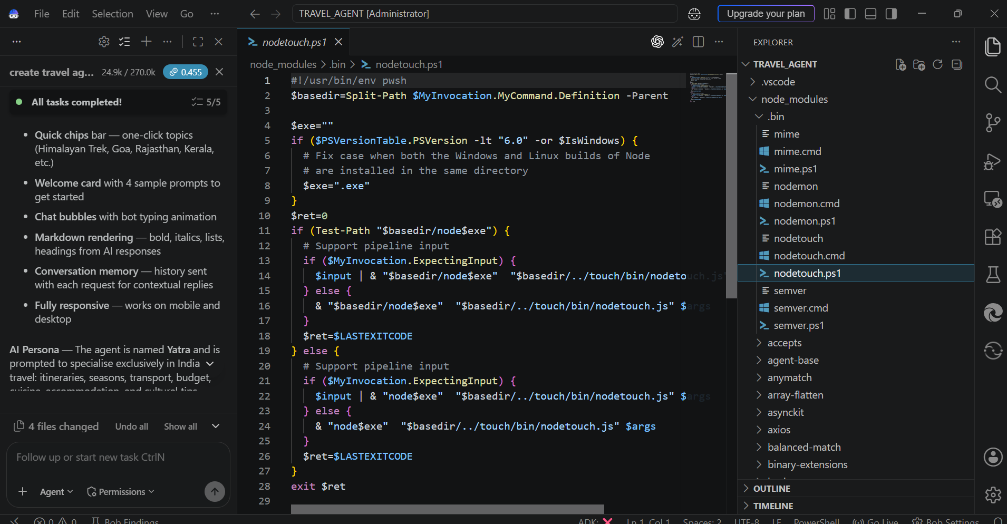
Required Files created using IBM bob -

Slide 7
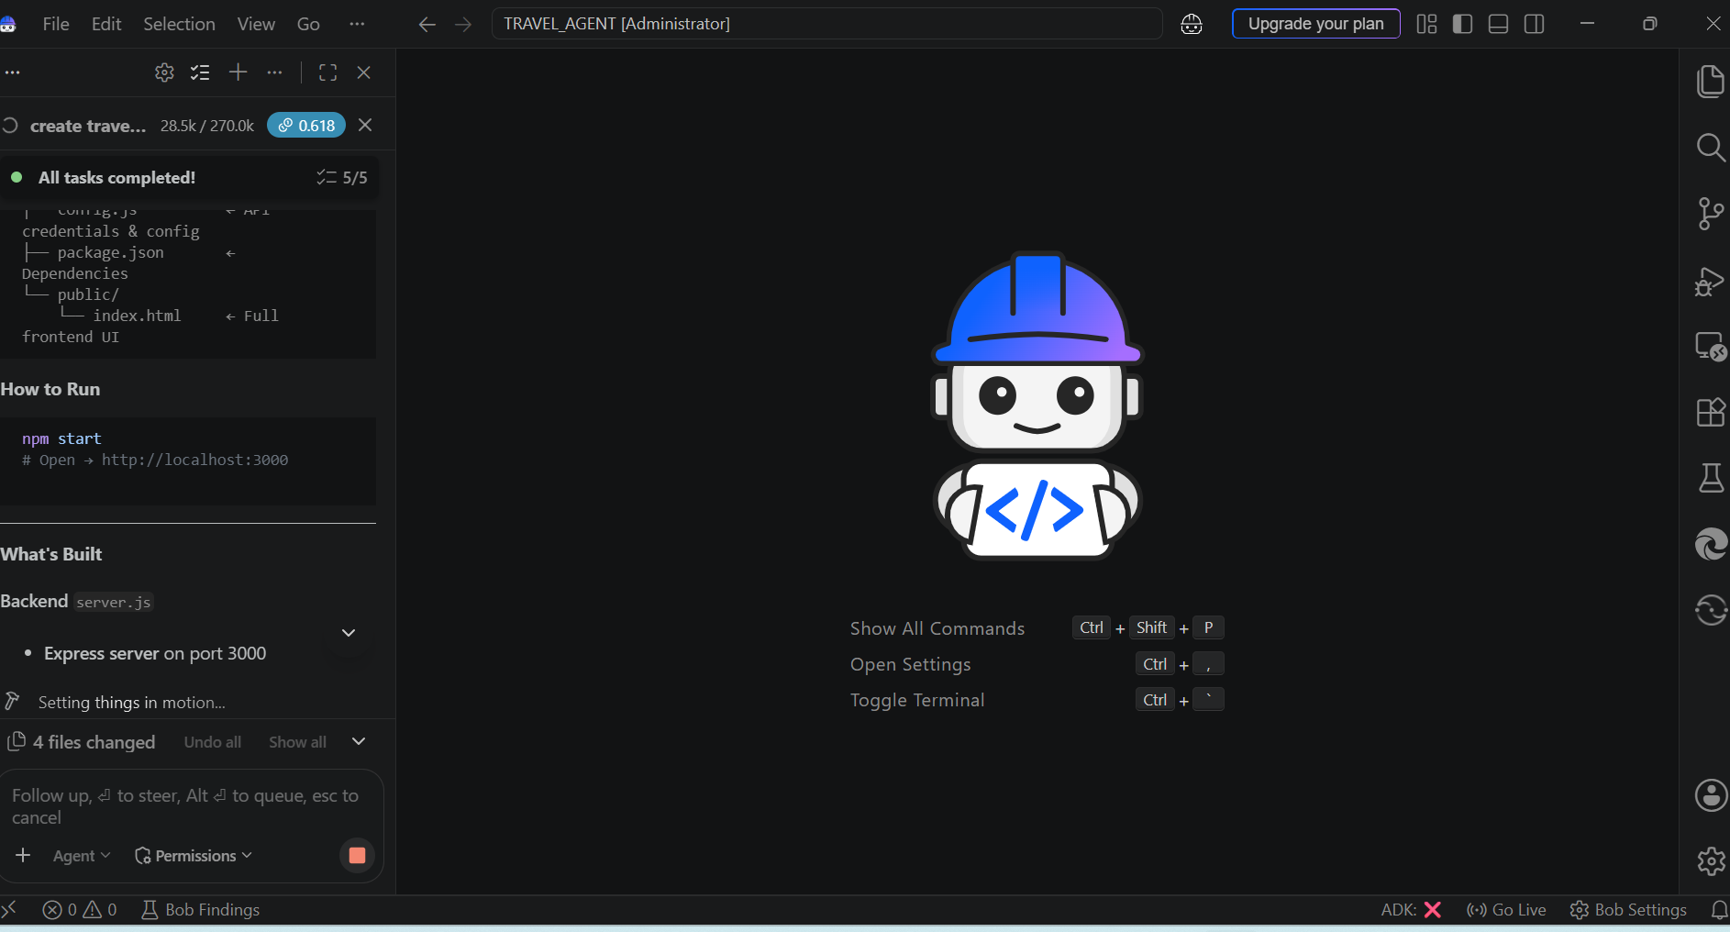
IBM Bob Screenshots:

Slide 9
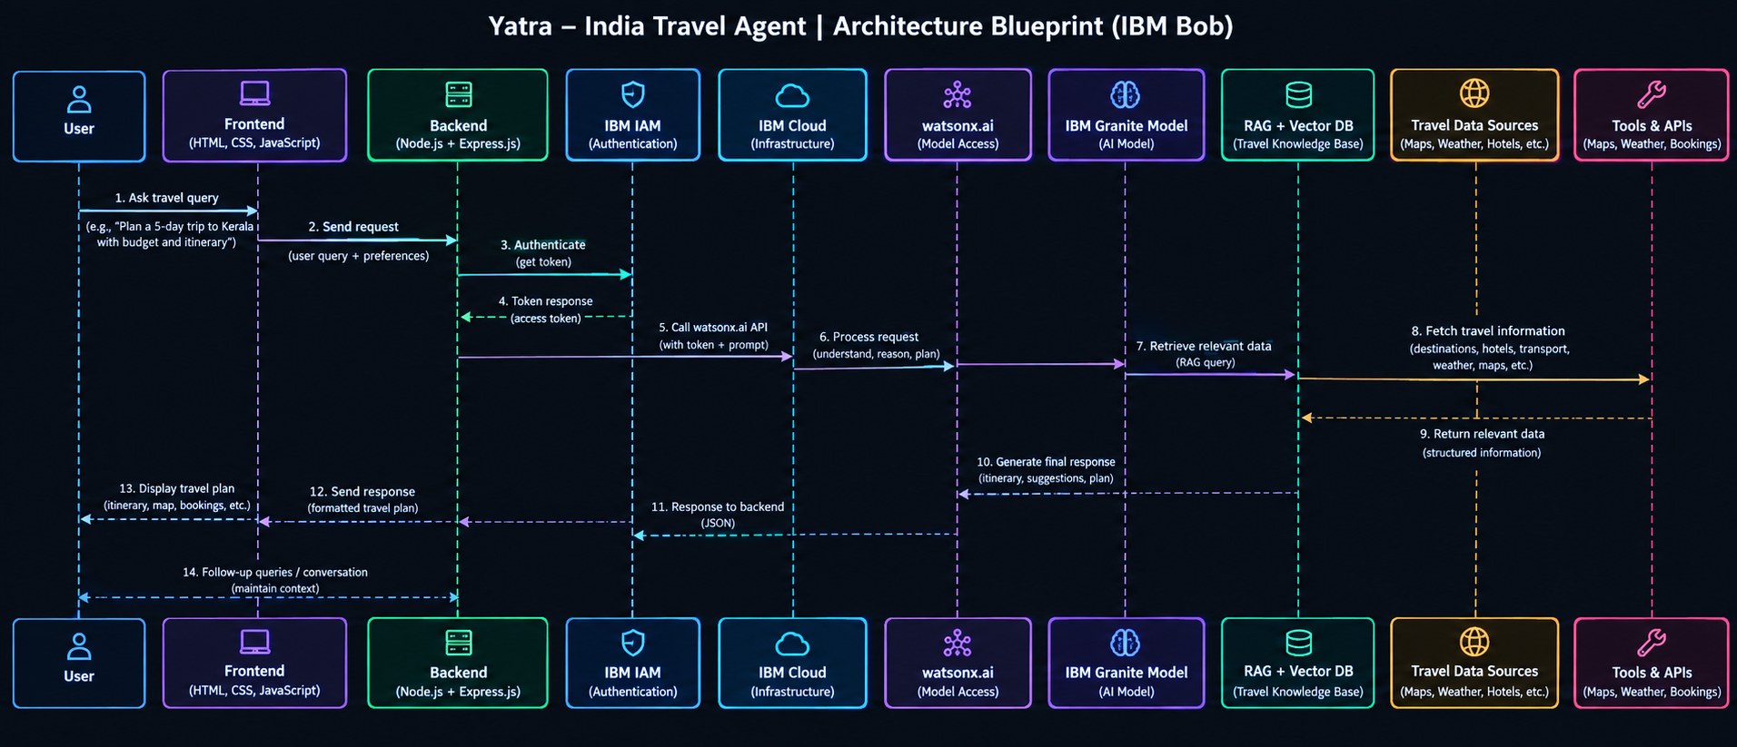
Architecture blueprint for IBM bob:

Slide 10

Role of Agentic AI in the solution
Role of Agentic AI in Travel Agent
Agentic AI acts as the intelligent decision-making system of the Yatra Travel Agent. Instead of only answering questions, it can understand the user's travel goals, plan tasks, use available tools/data, and generate a personalized travel plan.
Understands User Requirements – Identifies destination, duration, budget, interests, and preferences from natural-language queries.
Autonomous Trip Planning – Creates complete day-wise itineraries by deciding suitable destinations, activities, and schedules.
Personalized Recommendations – Adapts travel suggestions according to the user's budget, interests, and constraints.
Data & Tool Usage – Can use travel information such as maps, weather, transport, hotels, and local attractions when integrated with external tools/APIs.
Budget Optimization – Helps distribute the available budget across transport, accommodation, food, and activities.
Conversational Memory – Uses previous interactions to refine the itinerary when the user asks follow-up questions.
Dynamic Decision-Making – Can modify the travel plan when requirements or travel conditions change.
End-to-End Assistance – Brings destination discovery, itinerary planning, recommendations, and travel guidance together in one conversational agent.

Slide 11
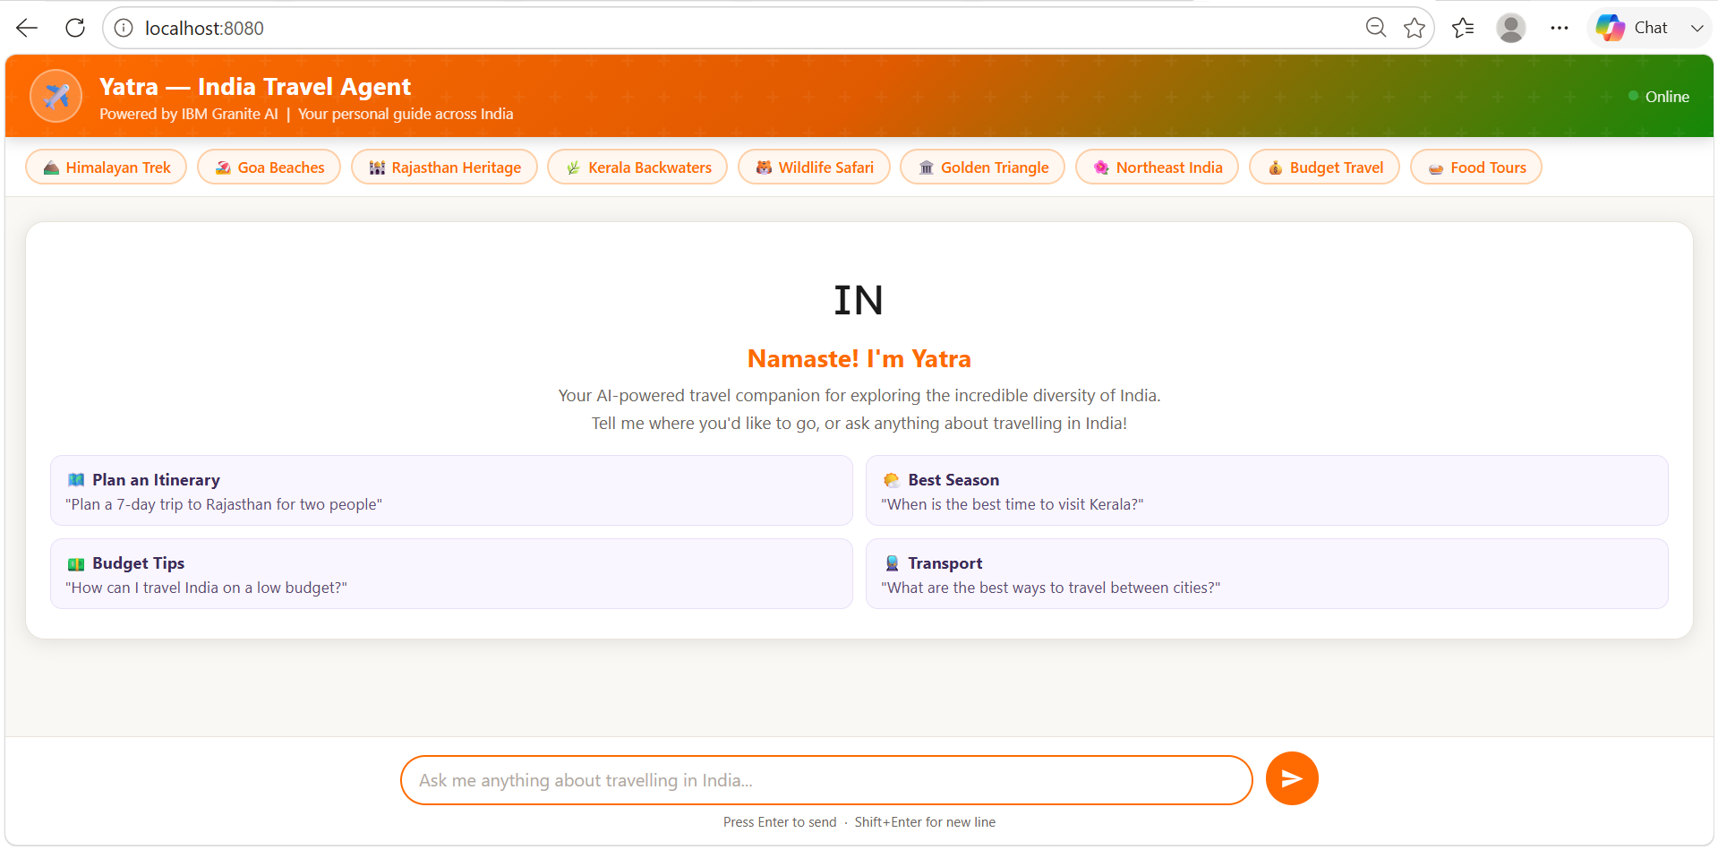
Project Output Screenshot
·
·
·

Slide 12
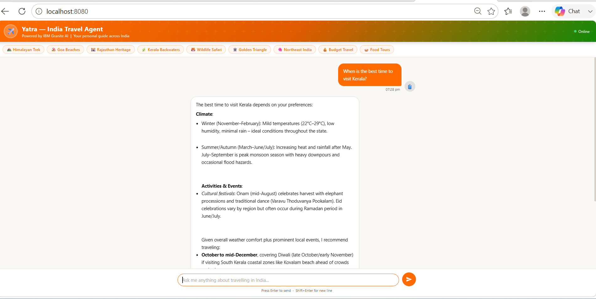
Project Output Screenshot
·
·
·

Slide 13
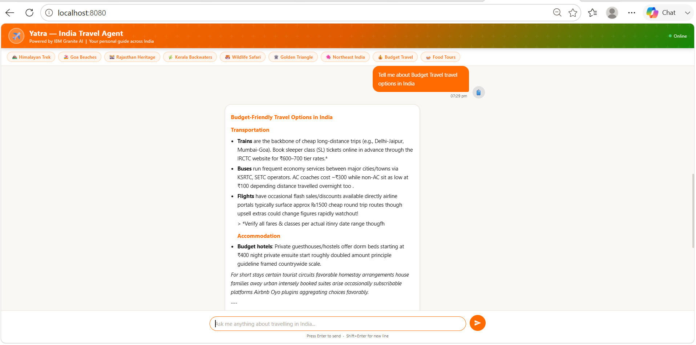
Project Output Screenshot
·
·
·

Slide 14
Novelty and Uniqueness
Yatra – India Travel Agent is an AI-powered travel planning system designed specifically for travel within India. Unlike traditional travel websites that mainly provide fixed information, Yatra understands the user's requirements through natural-language conversation and creates personalized travel plans.
Novelty:
Uses IBM Granite to provide conversational AI-based travel assistance.
Generates personalized day-wise itineraries based on destination, duration, budget, and interests.
Combines itinerary planning, transportation guidance, food recommendations, and cultural experiences in one platform.
Adapts recommendations based on follow-up conversations with the user.
Provides budget-conscious travel suggestions for different types of travelers.
Focuses on India-specific destinations, cuisine, culture, and travel experiences.
Uniqueness:
The main uniqueness of Yatra is its ability to act as a conversational travel agent rather than simply displaying pre-defined travel information. It converts a user's travel requirements into a structured and personalized travel plan using AI.

Slide 15
Git Hub Link
· Please create public github repository (Enable Add README button while creating repository) with format –
Please test and Paste the working Github URL –https://github.com/manaswitha138/TRAVEL_AGENT?utm_source=chatgpt.com
Make sure you have Uploaded following three files into your github repository
1) All Agent relevant files of IBM Cloud , 2) yourproblemstatement.pdf file 3) your projectpresntation.pptx file 4)any other files
·
·
·

Slide 16
Future Scope
Integration with real-time weather, maps, traffic, and transportation APIs.
Real-time hotel, flight, train, and ticket availability with booking support.
Voice-based interaction for easier and more natural travel planning.
Multilingual support for Indian regional languages.
Advanced budget optimization and personalized trip recommendations.
Integration of live location and route optimization during travel.
Personalized recommendations based on previous trips and user preferences.
Integration with local guides and tourism services.
Mobile application development for Android and iOS.
Continuous improvement using updated travel data and user feedback.
·
·
·

Slide 17
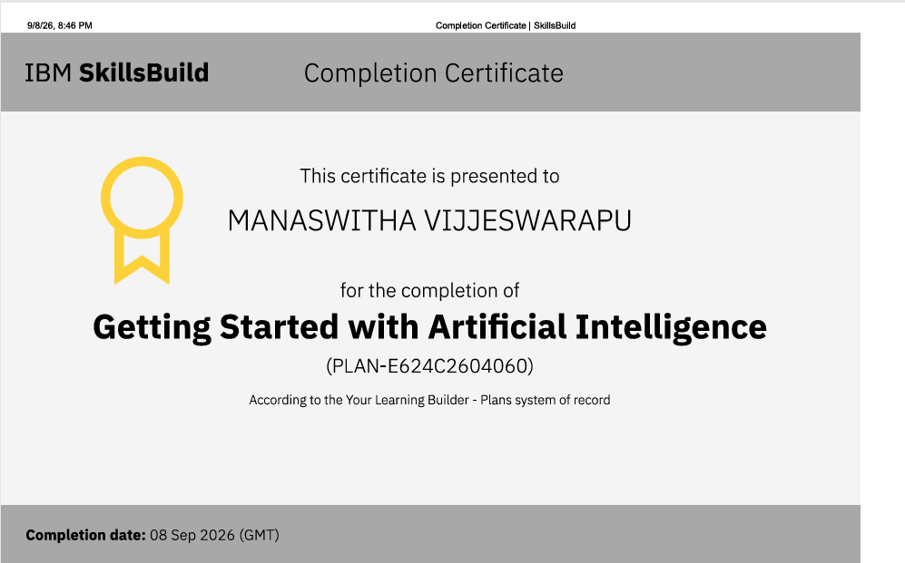
Certificates Earned:
Please add your credly certificate(Getting Started with Artificial Intelligence)

Slide 18
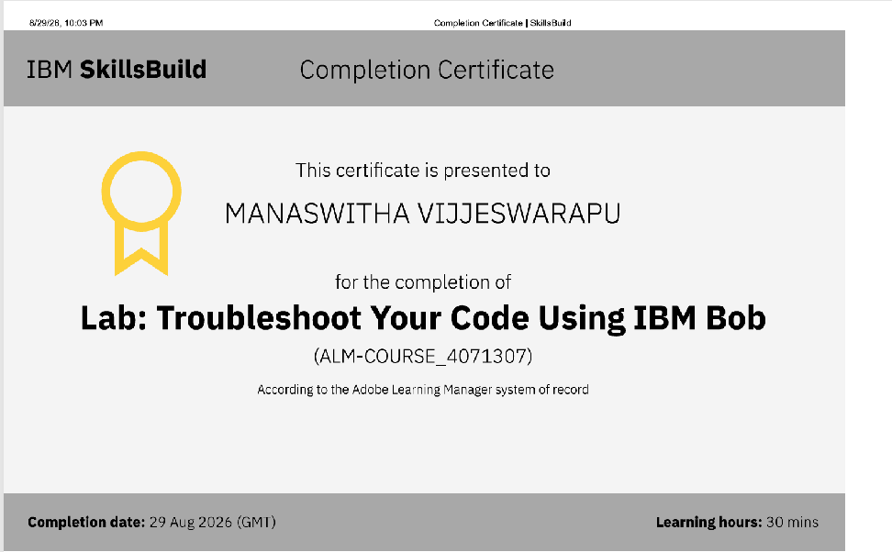
Certificates Earned:​
Add your IBM BOB Certificate

Slide 19


